Slide 1
Project Title : BBC News Articles Sorting.
PRESENTED BY
Sanket Andalkar
Rushikesh Pawar
Santosh Waghmode
PROJECT GUIDE
Ms.Ankita Kanchan
Symbiosis Skills
and
Professional University, Kiwale

Slide 2
OUTLINE
Introduction
Objectives
Data source
Exploratory Data Analysis
Text Preprocessing
Machine learning Model fitting
LSTM Model Fitting
Conclusion

Slide 3
Introduction :
This study uses Natural Language Processing, Machine learning and Neural Network models to predict category of BBC news.
Objectives
To predict the categories of the BBC news articles by using Machine Learning models and Neural Network models.
Data Source :
The data of BBC news articles is collected from the Kaggle website.

Slide 4
Natural Language Processing (NLP).
Natural Language Processing is defined as understanding text or speech with the aid of any software program or machine.
An analogy is that humans can interact and understand each other views and reply with the perfect answer. In NLP, a computer made interactions, not a human.
Applications of NLP
➢ Sentiment Analysis
➢ Chatbots
➢ Machine Translation
➢ Auto-Correct
➢ Speech Recognition
➢ Keyword-Search
➢ Virtual Assistants
NLTK Library :
NLTK stands for Natural Language Tool Kit and is one of the most powerful NLP libraries.
Natural Language Tool Kit is the mother of all NLP libraries.
Machine Learning projects and data pre-processing use NLTK.
It is used in data pre-processing.

Slide 5
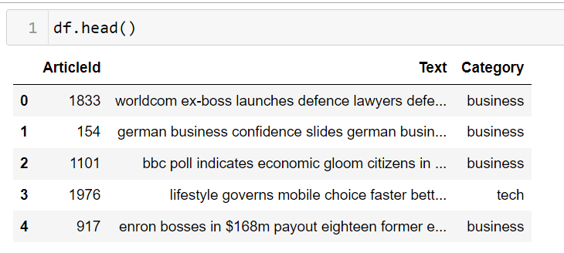
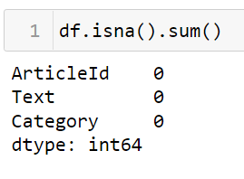
Exploratory Data Analysis
Data :
Null values :

Slide 6
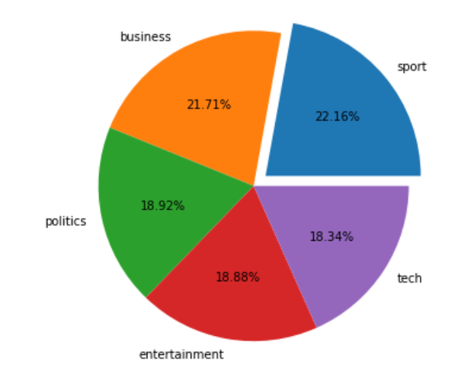
Pie chart of Categories in dataset :
Conclusion :
The proportion of categories in dataset are almost similar.
There is no bias in dataset.

Slide 7
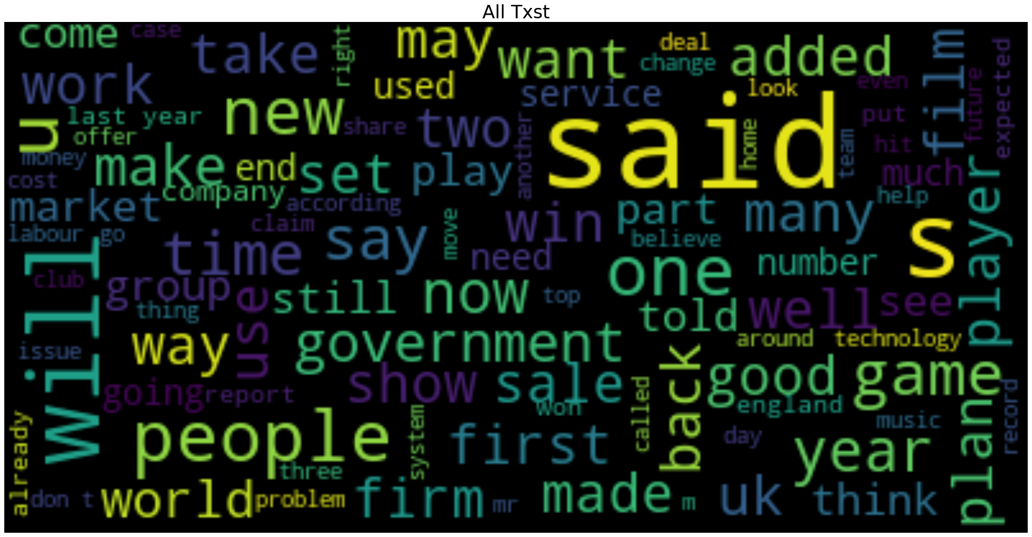
Word Cloud for Articles :

Slide 8
Text preprocessing in NLP
In NLP, text preprocessing is the first step in the process of building a model.
The various text preprocessing steps are:
➢ Clean Text
➢ Lower casing
➢ Tokenization
➢ Stop words removal
➢ Stemming
➢ Lemmatization
Function to clean Text and lower case the text
def CleanText(text):
text=re.sub('\d',' ',text) # Remove number
text=re.sub(' +',' ',text) # Remove extra spaces
text = "".join([char.lower() for char in text if char not in string.punctuation]) # Removing punctuation and normalization
return text

Slide 9
Tokenization
Splitting the sentence into words.
Tokenization is the first step in text analytics. It is the process of breaking down a textual content paragraph into smaller chunks.
A token is a single entity which is building block for sentence or paragraph. For example, each word is a token if a sentence “tokenized” in words.
Every word is a token if a sentence is tokenized into a word.
# Tokenization
def tokenize(text):
token=word_tokenize(text)
return token
df["token_Text"]=df["clean_Text"].apply(tokenize)
df.head()

Slide 10
Stop words removal
• Stop words are very commonly used words (a, an, the, etc.) in the documents.
• These words do not really signify any importance as they do not help in distinguishing two documents.
# Remove stop words
from nltk.corpus import stopwords
nltk.download('stopwords')
stopwords = nltk.corpus.stopwords.words('english')
def remove_stopwords(text):
txt_clean = [word for word in text if word not in stopwords]
return txt_clean
df["stop_Text"]=df["token_Text"].apply(remove_stopwords)
df.head()

Slide 11
Stemming
Stemming is the process of removing a part of a word, or reducing a word to its stem or root.
A stemming algorithm might also reduce the words fishing, fished, and fisher to the stem fish.
The stem need not be a word, for example the Porter algorithm reduces, argue, argued, argues, arguing, and argus to the stem argu.
from nltk.stem import PorterStemmer
ps=PorterStemmer()
def stemming(text):
stem_text=[ps.stem(word) for word in text]
return stem_text
df["stem_Text"]=df["stop_Text"].apply(stemming)
df.head()

Slide 12
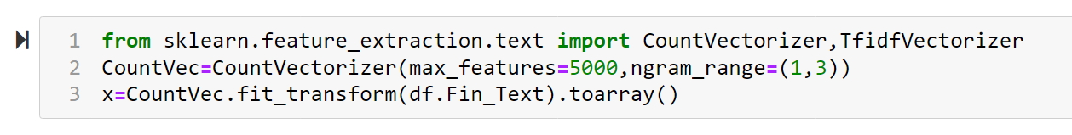
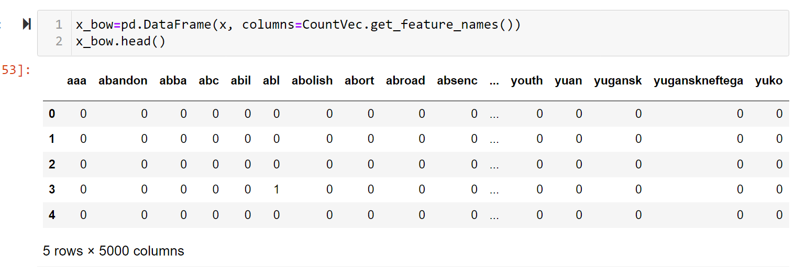
Bag of Word :
A bag of words is a representation of text that describes the occurrence of words within a document.
We just keep track of word counts and disregard the grammatical details and the word order.
It is called a “bag” of words because any information about the order or structure of words in the document is discarded.
A bag-of-words model is a way of extracting features from text for use in modelling, such as with Machine Learning algorithms. In this approach we look at the histogram of the words within the text. i.e. Considering each word count as a feature.

Slide 13


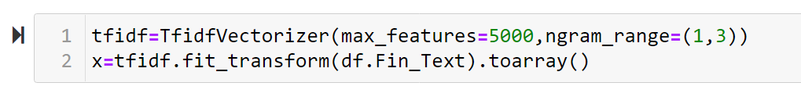
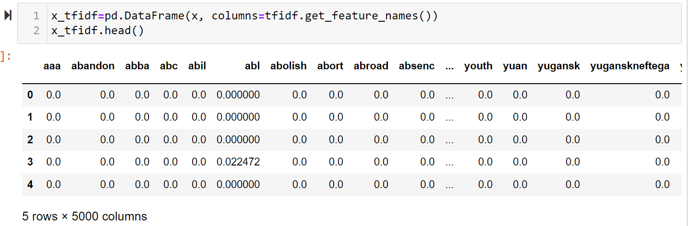
TF-IDF (Term Frequency - Inverse Document Frequency):
TF-IDF is a statistical measure that evaluates how relevant a word is to a document in a collection of documents.
This is done by multiplying two metrics: how many times a word appears in a document, and the inverse document frequency of the word across a set of documents.

Slide 14
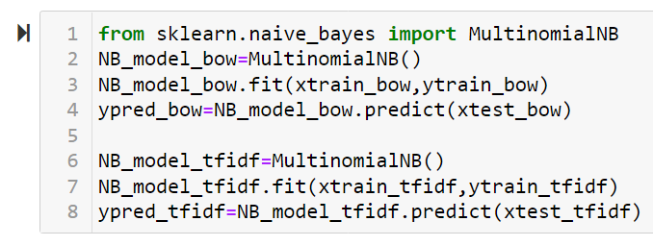
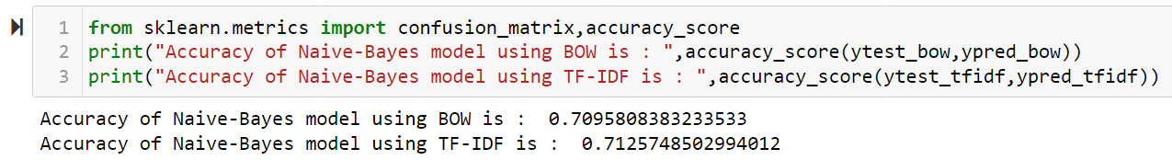
Fitting Machine Learning Algorithms.
Naïve-Bayes :
Naive Bayes is a kind of classifier which uses the Bayes Theorem.
It predicts membership probabilities for each class such as the probability that given record or data point belongs to a particular class. The class with the highest probability is considered as the most likely class.
They calculate the probability of each category for a given text and then output the category with the highest one.
Advantage :
It is easy and fast to predict class of test data set. It also perform well in multi class prediction.
When assumption of independence holds, with less training data a Naive Bayes classifier performs better compare to other models like logistic regression.

Slide 15
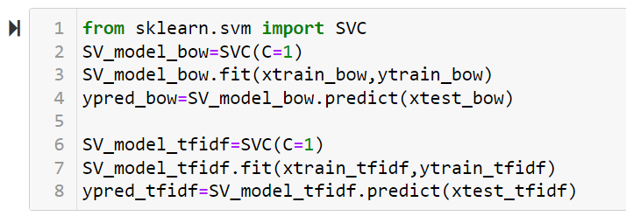
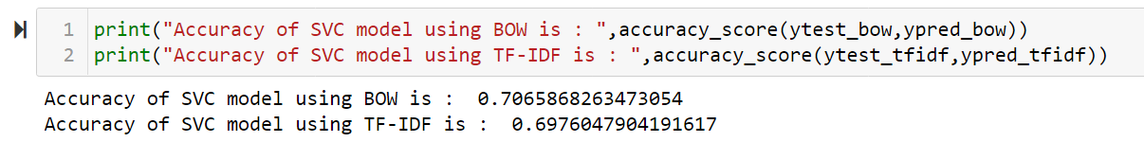
SVM :
For classification problem statements SVM tries to differentiate data points of different classes by finding a hyperplane that maximize the margin between the classes in the training data.

Slide 16
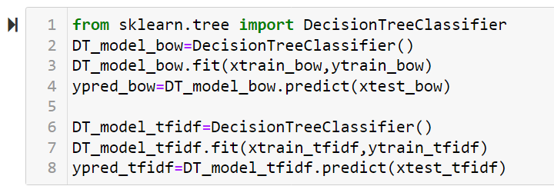
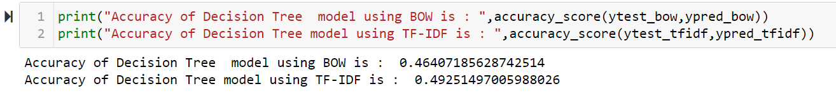
Decision Tree:
A Decision Tree is a supervised machine learning algorithm that can be used for both regression and classification problem .
Decision Tree divides complete dataset into smaller subsets while at a same time associated decision tree is incrementally develop.
Final output of the Decision tree is a tree having decision nodes and leaf nodes.

Slide 17
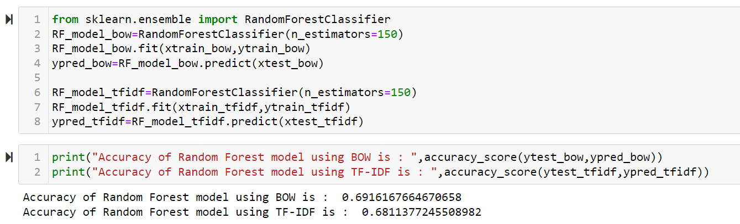
Random Forest :
Random forest is an ensemble algorithm that follows the bagging technique. It is an extension of bagging estimator algorithm the base estimators in random forest are decision tree.
Random Forest randomly select set of features which are used to decide a best split at each node of the decision tree.
The final prediction is taken by the majority of class from all decision trees.

Slide 18
Word Embedding :
Word embedding is one of the most popular representation of document vocabulary. It is capable of capturing context of a word in a document, semantic and syntactic similarity, relation with other words, etc.
Loosely speaking, they are vector representations of a particular word.
Why we use Word Embedding?
Bag of word and TF-IDF has one disadvantage that it does not gives semantic information. To overcome the problem of BOW and TF-IDF we use word embedding technique.
Word embedding techniques include two techniques
1) Word2Vec
2) Glove
Word2Vec :
Word2Vec algorithm uses neural network model to learn association from large corpus of test. Once trained, such a model can detect a synonymous words or suggest additional words for a partial sentence.
In this specific model, each word is basically represented as vector of 32 or more dimension instead of single number.
Here the semantic information and the relationship between different words is also preserved.

Slide 19
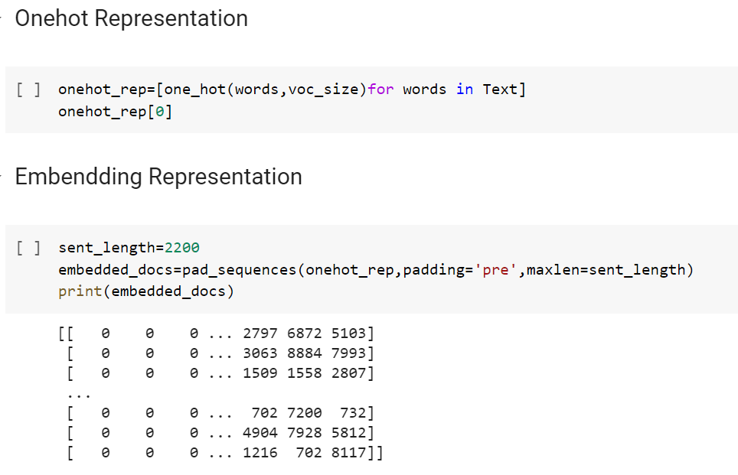
Onehot Representation :
A one hot encoding allows the representation of Text data to be more expressive because machine learning algorithms cannot work with text data directly. The words must be converted into numbers.
Padding :
To get equal number of size of sentence we add some zero values to left side of sentence by using ‘padding’ technique.

Slide 20

LSTM Model :
Humans don’t start their thinking from scratch every second. As you read this essay, you understand each word based on your understanding of previous words. You don’t throw everything away and start thinking from scratch again. Your thoughts have persistence.
Traditional neural networks can’t do this, and it seems like a major shortcoming. For example, imagine you want to classify what kind of event is happening at every point in a movie. It’s unclear how a traditional neural network could use its reasoning about previous events in the film to inform later ones.
Recurrent neural networks address this issue. They are networks with loops in them, allowing information to persist.
Long Short-Term Memory networks usually just called “LSTMs” are a special kind of RNN, capable of learning long- term dependencies. They work tremendously well on a large variety of problems, and are now widely used.
LSTMs are explicitly designed to avoid the long-term dependency problem. Remembering information for long periods of time is practically their default behaviour , not something they struggle to learn!
The repeating module in an LSTM contains four interacting layers

Slide 21
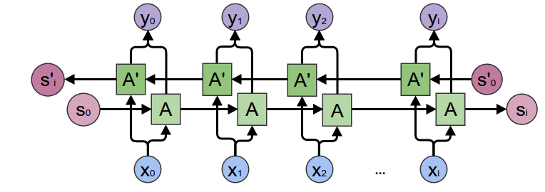
Bidirectional LSTM :
Bidirectional LSTMs are an extension of traditional LSTMs that can improve model performance on sequence classification problems. In problems where all time steps of the input sequence are available, Bidirectional LSTMs train two instead of one LSTMs on the input sequence.

Slide 22
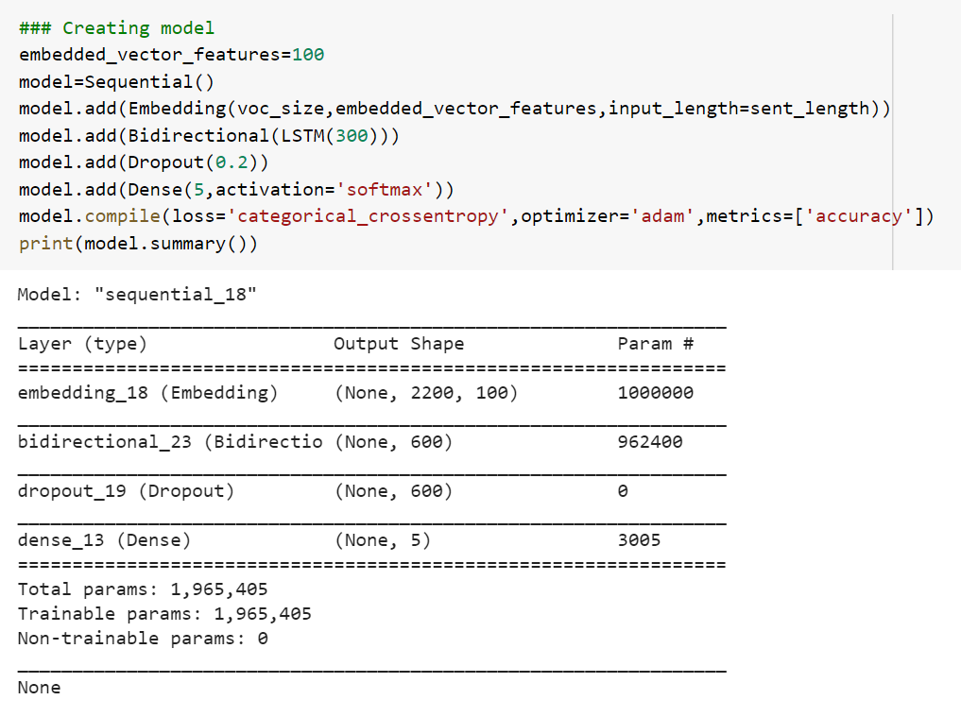
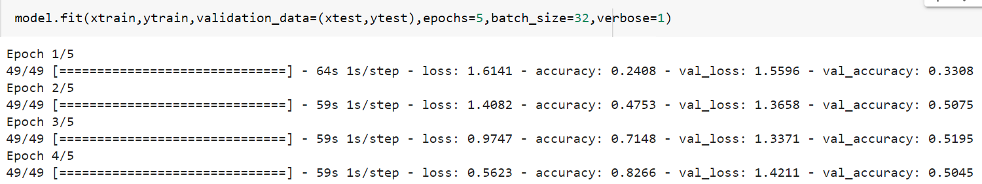
Training Model :

Slide 23
Model Accuracy Table :
ML Models | Accuracy with BOW | Accuracy with TF-IDF
Naïve Bayes | 70.95% | 71.25%
SVM | 69.16% | 68.11%
Decision Tree | 46.40% | 49.25%
Random Forest | 69.16% | 68.11%
Neural Network Model | Accuracy
Bidirectional LSTM | 51.25%
Conclusion :
From the above models we conclude that for sorting of BBC’s news article Naïve Bayes gives highest Accuracy i.e 71.25 % using TF-IDF feature extraction method.

Slide 24
Thank You..

